Slide 1
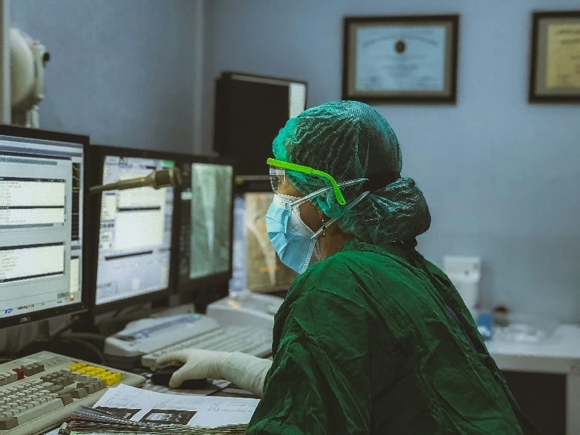
Innovative Monitoring System for TeleICU Patients Using Video Processing and Deep Learning
Presented by:
Praful V Kulkarni
Tejas A R

Slide 2
Solution:
Constantly Analyzing Video: Patients are checked for changes using video processing and deep learning to monitor them in real time.
Early Recognition: Deep learning algorithms can be employed for recognizing early stages of patient’s deterioration.
Data Fusion: This enables combining video data and other patient information so that patients can be monitored comprehensively.
Remote Entry and Notifications: It gives healthcare professionals an interface that is simple to operate and helps them stay informed using smart alerts.

Slide 3
Features Offered:
Accurate Identification: Helps distinguish between patients and doctors in ICU settings using YOLOv8.
Real-Time Updates: Provides instant updates when a patient is detected for timely intervention.
High Precision and Speed: Ensures swift and accurate detection, crucial for ICU monitoring.
Scalable and Adaptable: Handles diverse ICU scenarios, adaptable to various healthcare settings.

Slide 4
Process flow:
Dataset Collection and Labeling: Collect and label ICU room photographs featuring patients, physicians, and nurses.
Model Training (YOLOv8):Train YOLOv8 on the labeled dataset using Python.
Model Deployment: Deploy the trained model to ICU video data or live feed.
Real-time Detection and UI Update: Implement real-time detection using the deployed model. Update the user interface to display and prompt based on detection results

Slide 5
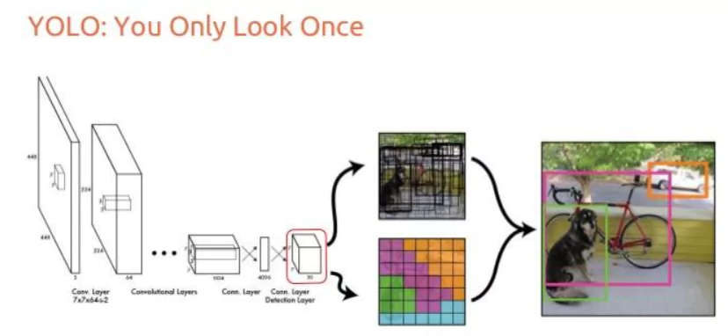
Architecture Diagram:
Dataset
Detected result updated

Slide 6
Technologies used:
Yolov8 for object detection.
Roboflow for updating annotations for the different classes for object detection.
PyCharm - python language IDE.
OpenCV for image and video processing in python.

Slide 7
Team members and contribution:
Team member 1:- Praful V K – Coding and analysis.
Team member 2:- Tejas A R – Planning and dataset arrangement.

Slide 8
Conclusion
Enhanced Monitoring: YOLOv8 deployment enables real-time detection of individuals in ICU settings, enhancing monitoring capabilities.
Operational Efficiency: Automation reduces manual oversight, allowing healthcare staff to prioritize patient care over monitoring tasks.
Immediate Alerts: Real-time alerts from the system facilitate quick responses to critical events, improving situational awareness.
Continuous Improvement: Ongoing updates and refinements ensure the system evolves to meet changing needs, supporting effective ICU management.

Slide 9
Thank You!

